Slide 1

Unveiling the Flavorful Insights: A Delectable Dive into Swiggy Data Analysis

Slide 2
Objective
The objective of this presentation is to analyze the Swiggy dataset to gain insights into customer behavior, popular food items, delivery trends, and restaurant performance. By examining key metrics and trends, we aim to provide actionable recommendations to improve service, increase customer satisfaction, and drive business growth.

Slide 3

What are the top-rated restaurants in each city?
Bangalore
Ahmedabad

Slide 4






Which cities have the highest average cost per person for dining?
Bangalore
386
Ahmedabad
354

Slide 5
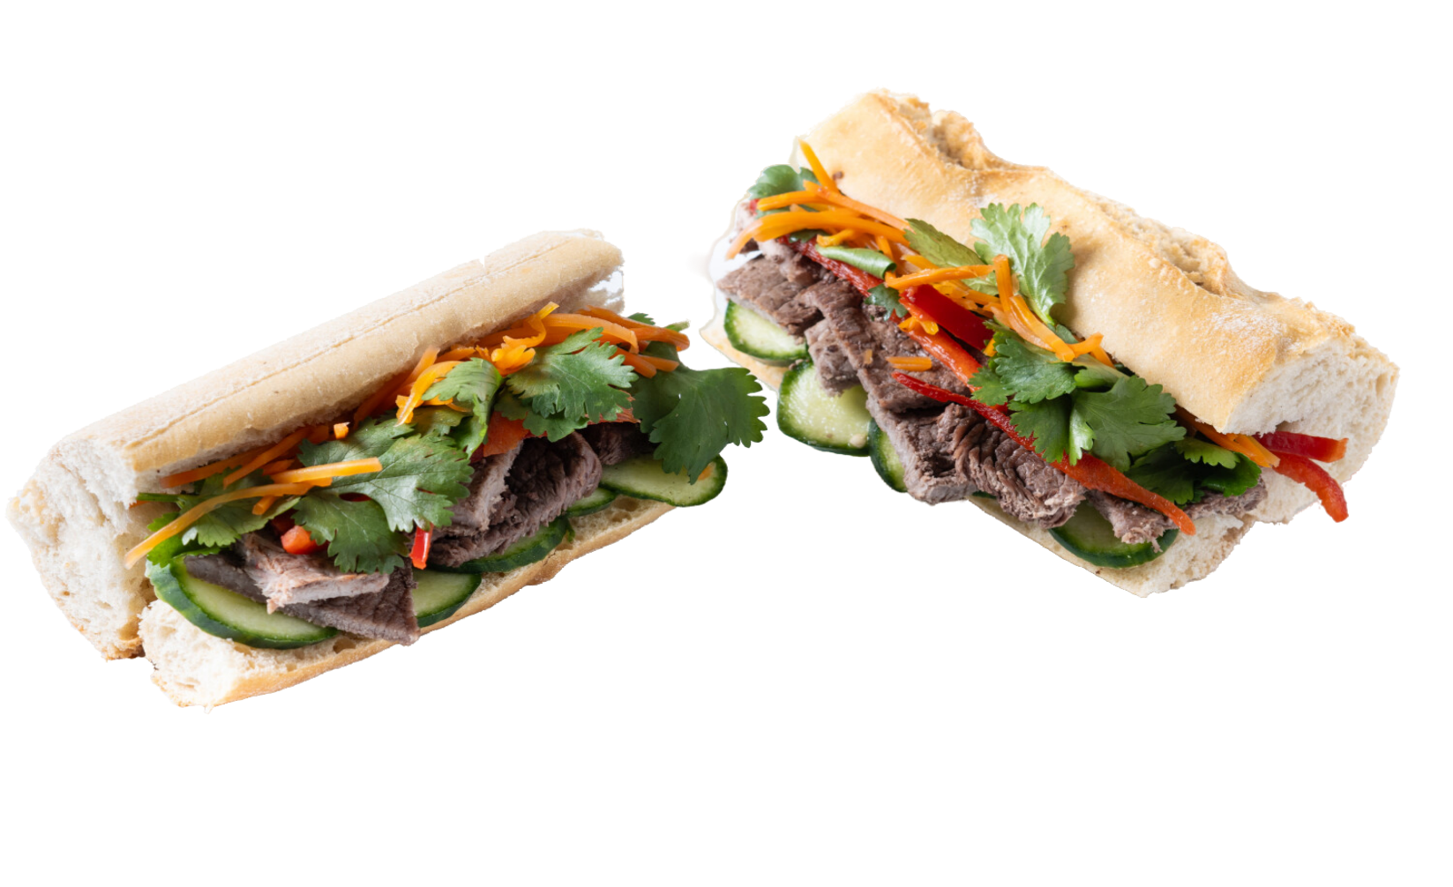
Are there any correlations between restaurant ratings and the cost per person?
No significant correlation found between restaurant ratings and cost per person.
Ratings and cost per person can be influnced by unmeasured factors like location, menu variety, online reviews, or overall dining experience.
Highlights importance of focusing on overall experience, not just pricing, for higher ratings.

Slide 6
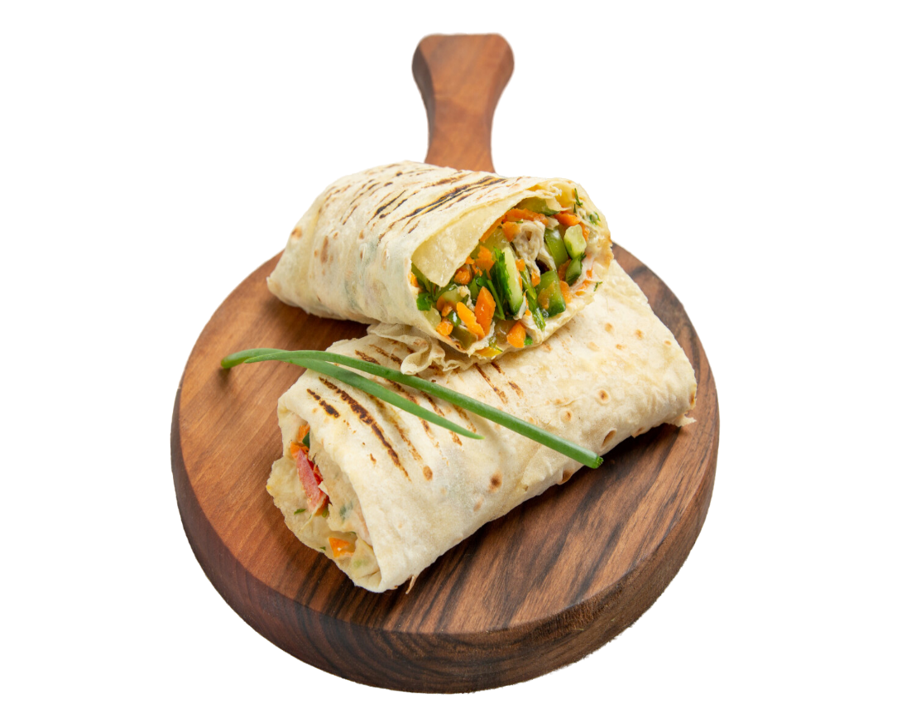

Which restaurant has the most extensive menu?

Slide 7

What cuisines are most popular in each city?

Slide 8

How does the cost per person vary across different menu categories

Slide 9
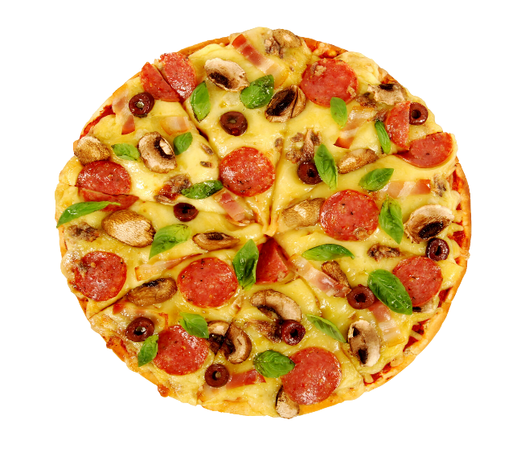





What is the average price difference between vegetarian and non-vegetarian items?
Non-Veg
Avg Price Difference
118
Veg

Slide 10

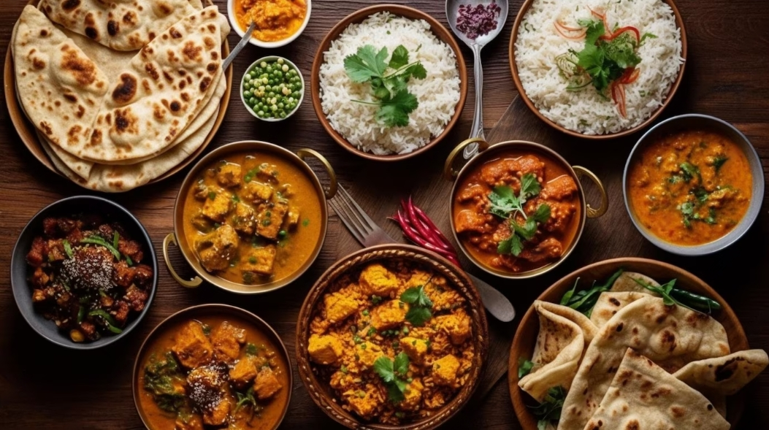


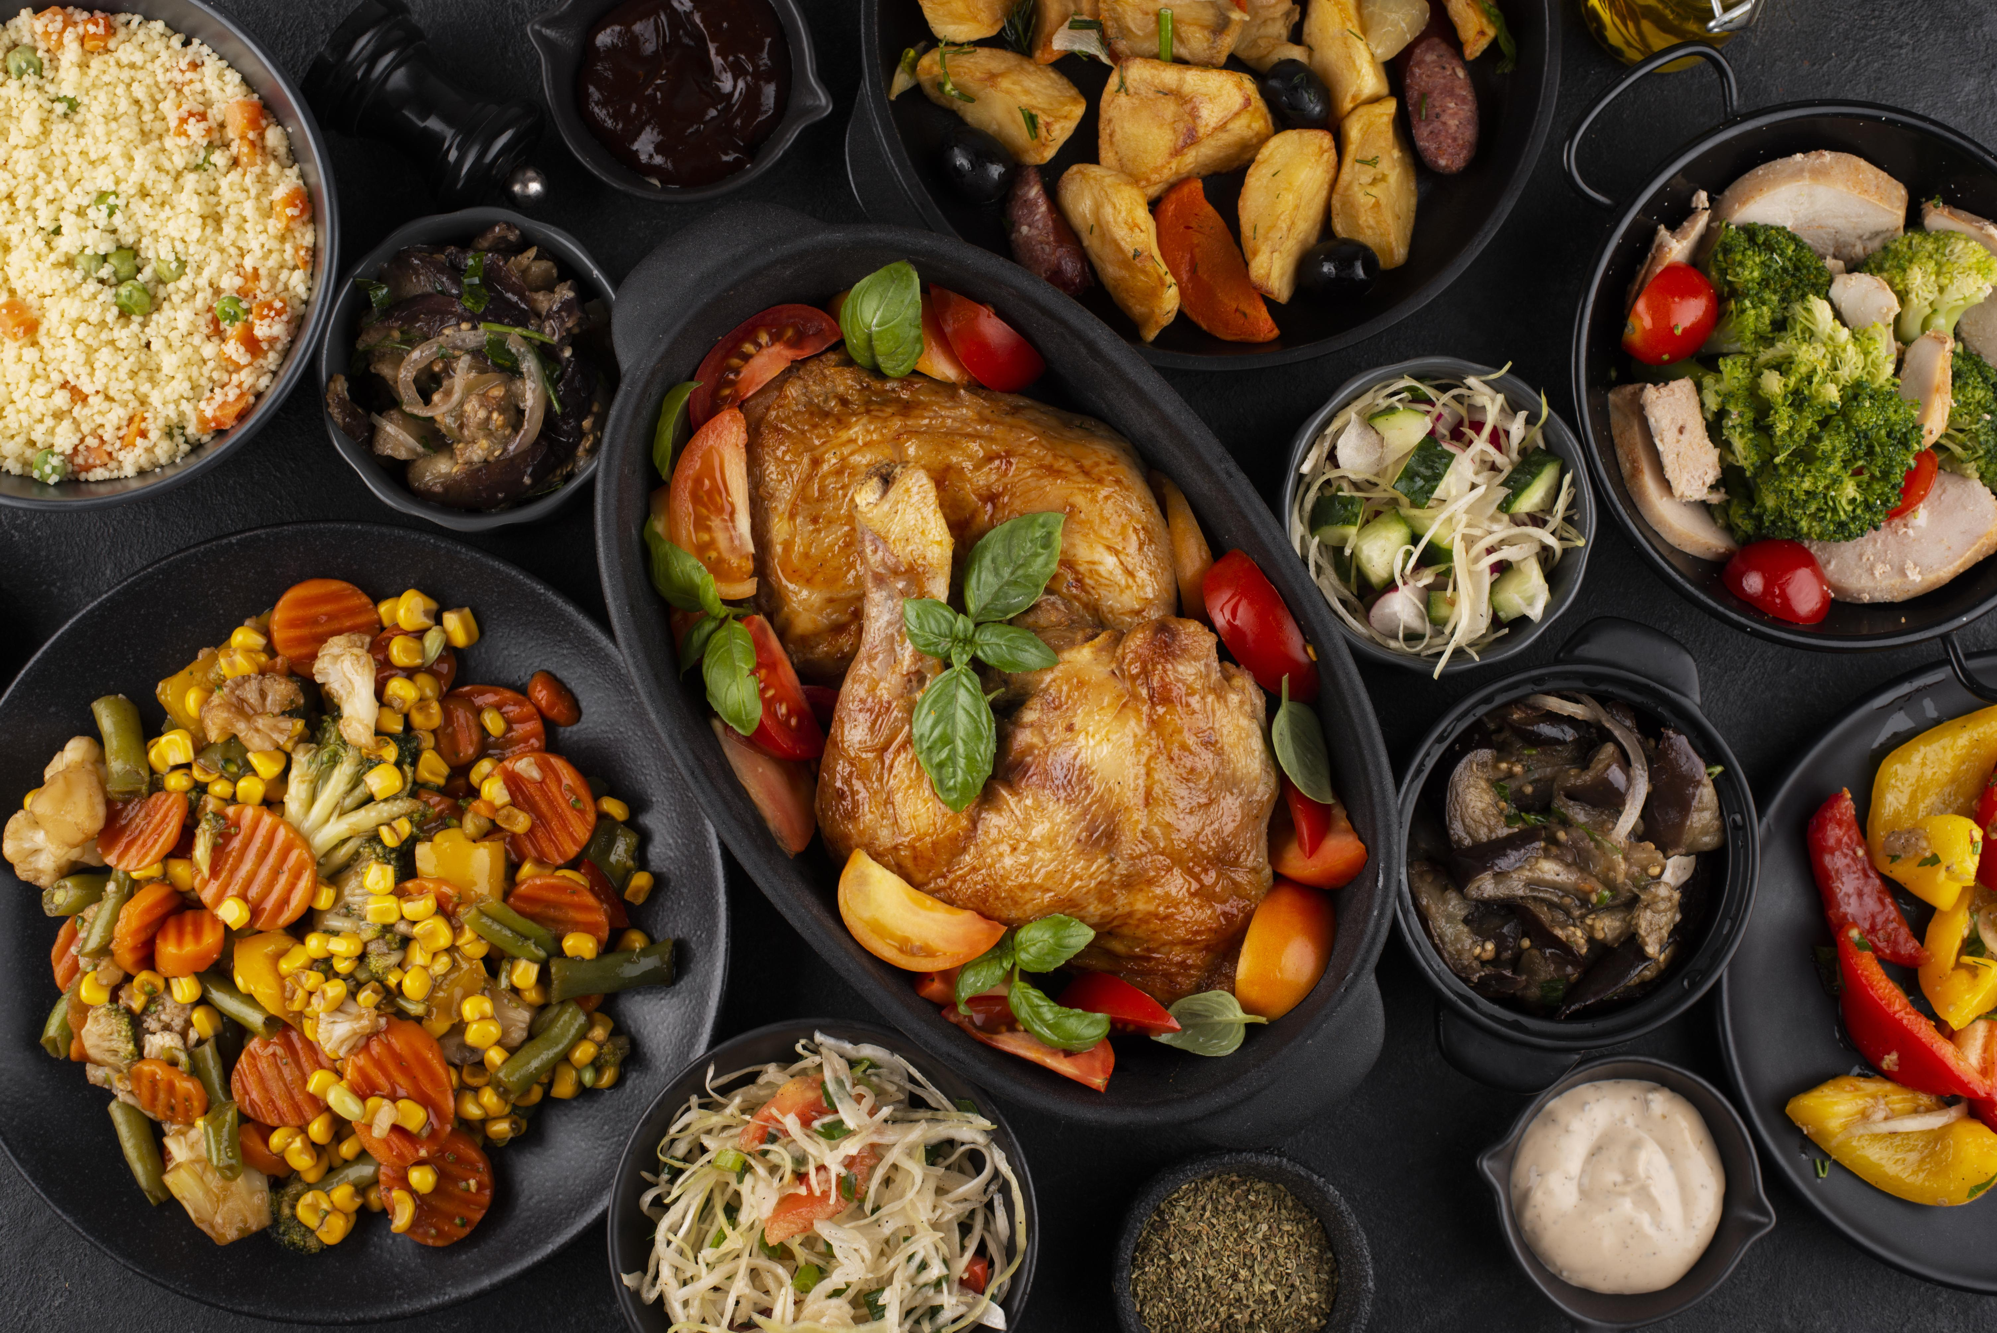
How do customer ratings differ for veg and non-veg items?
Veg
Non-Veg

Slide 11
Insights
Top-Rated Restaurants: Bangalore and Ahmedabad feature highly-rated restaurants (4.5+), showcasing a vibrant culinary scene.
Average Cost Per Person: Ahmedabad offers slightly more affordable dining experiences compared to Bangalore.
Most Extensive Menu: Oven Story Pizza leads with the most extensive menu, followed by Subway and Faasos - Wraps & Rolls.
Correlation Between Ratings and Cost: No significant correlation was found between restaurant ratings and cost per person, emphasizing the importance of factors like food quality and service in influencing ratings.
Popular Cuisines: Indian Chinese, Fast Food, Snacks, and Biryani and Mughlai are favored in Ahmedabad, while North Indian, Chinese and South Indian cuisines dominate in Bangalore.
Menu Category Cost Variation: Prices vary widely across menu categories, with some, like Chopsuey and Delights Dishes, being more expensive, and others more affordable.
Price Difference (Veg vs. Non-Veg): Non-veg items are priced higher on average than veg items, with a notable price difference.
Customer Ratings (Veg vs. Non-Veg): There is no significant difference in customer ratings between vegetarian and non-vegetarian items, indicating food quality is paramount to customers regardless of type.

Slide 12
Thanks!
Do you have any questions?
tiwarirashi322@gmail.com

